Slide 1

Taking back control … …of confounding factors by Ralf Martin (r.martin@imperial.ac.uk)
FKA
Multivariate regression

Slide 2
Objectives for this lecture
Learn how to include further (control) variables in a regression ⇒ Multivariate regression
Interpret multivariate regressions properly
Understand that including more variables is not always better
Learn how to perform hypothesis tests involving several parameters

Slide 3
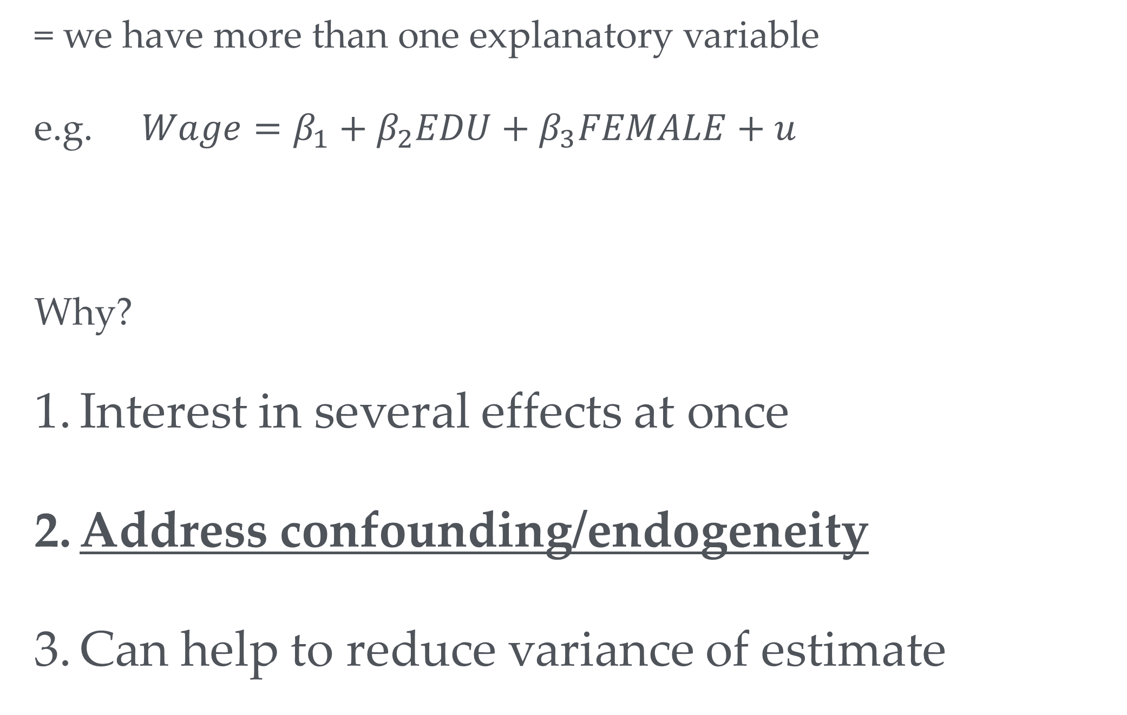
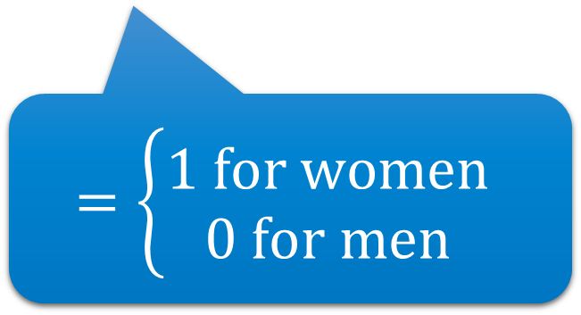
Why Multivariate Regression?
= we have more than one explanatory variable
e.g. $Wage=β_{1}+β_{2}EDU+β_{3}FEMALE+u$
Why?
Interest in several effects at once
Address confounding/endogeneity
Can help to reduce variance of estimate
$$=\left\{\begin{aligned}1 for women \\ 0 for men\end{aligned}\right.$$
Years of Schooling

Slide 4
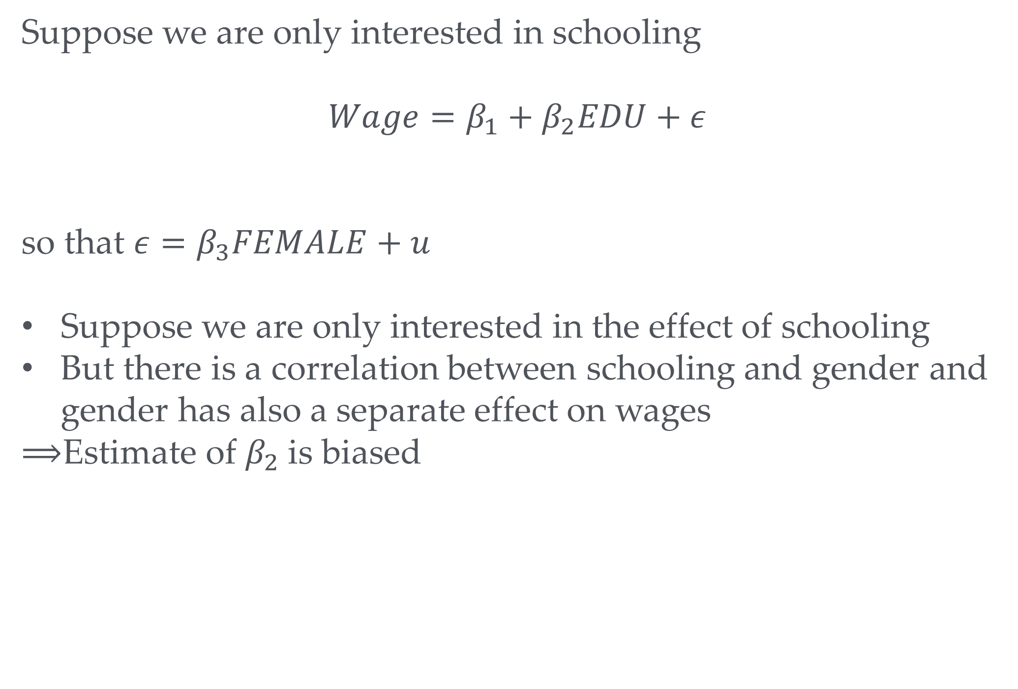
Endogeneity and Multivariate Regression
Am not trying (or succeeding) to be misogynistic here. It’s simply what we find in the data as we shall see later
Suppose we are only interested in schooling
$Wage=β_{1}+β_{2}EDU+ε$
so that $ε=β_{3}FEMALE+u$
Suppose we are only interested in the effect of schooling
But there is a correlation between schooling and gender and gender has also a separate effect on wages
$⟹$Estimate of $β_{2}$is biased
e.g. women tend to have less schooling
Your turn: What bias do you expect?
Upward, downward, none?

Slide 5
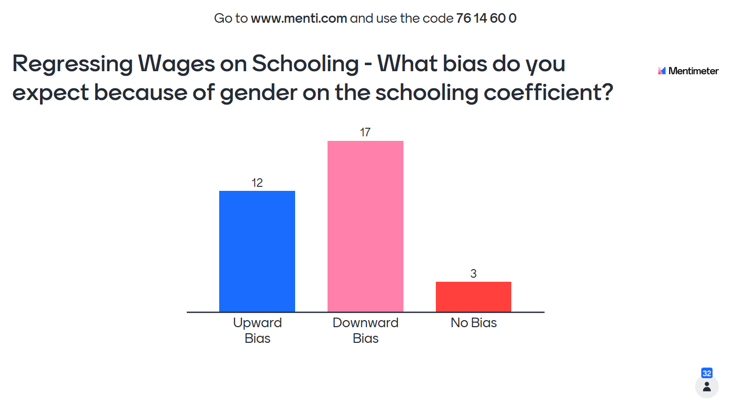


$$Wage=β_{1}+β_{2}EDU+ε$$
$ε=β_{3}FEMALE+u$
$Wage=β_{1}+β_{2}EDU+ε$

Slide 6

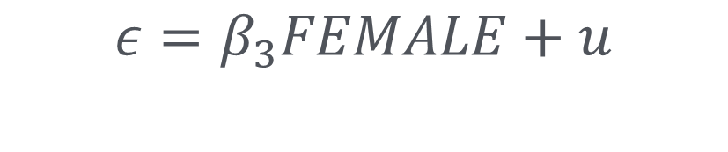

Endogeneity and Multivariate Regression
-
$Wage=β_{1}+β_{2}EDU+ε$
+
$$ε=β_{3}FEMALE+u$$
$$β_{3}<0$$
Negative effect of FEMALE on WAGE and EDU implies positive correlation between $ε$
We get upward bias when attempting to estimate $β_{2}$

Slide 7


Endogeneity and Multivariate Regression
To avoid the problem we can include $FEMALE$as additional variable:
$$Wage=β_{1}+β_{2}EDU+β_{3}FEMALE+u$$
We get a different regression model with a different residual term $u$
This will lead to an unbiased ${\hat{β}}_{2}$ if $EDU$is independent (i.e. uncorrelated) with $u$

Slide 8
A stylised example

Slide 9

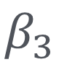
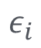

A stylised example
Positive $ε$-shocks when EDU is high
Negative $ε$-shocks when EDU is low
True model in univariate case
$$ε_{i}$$
Men
$$β_{3}$$
Women

Slide 10

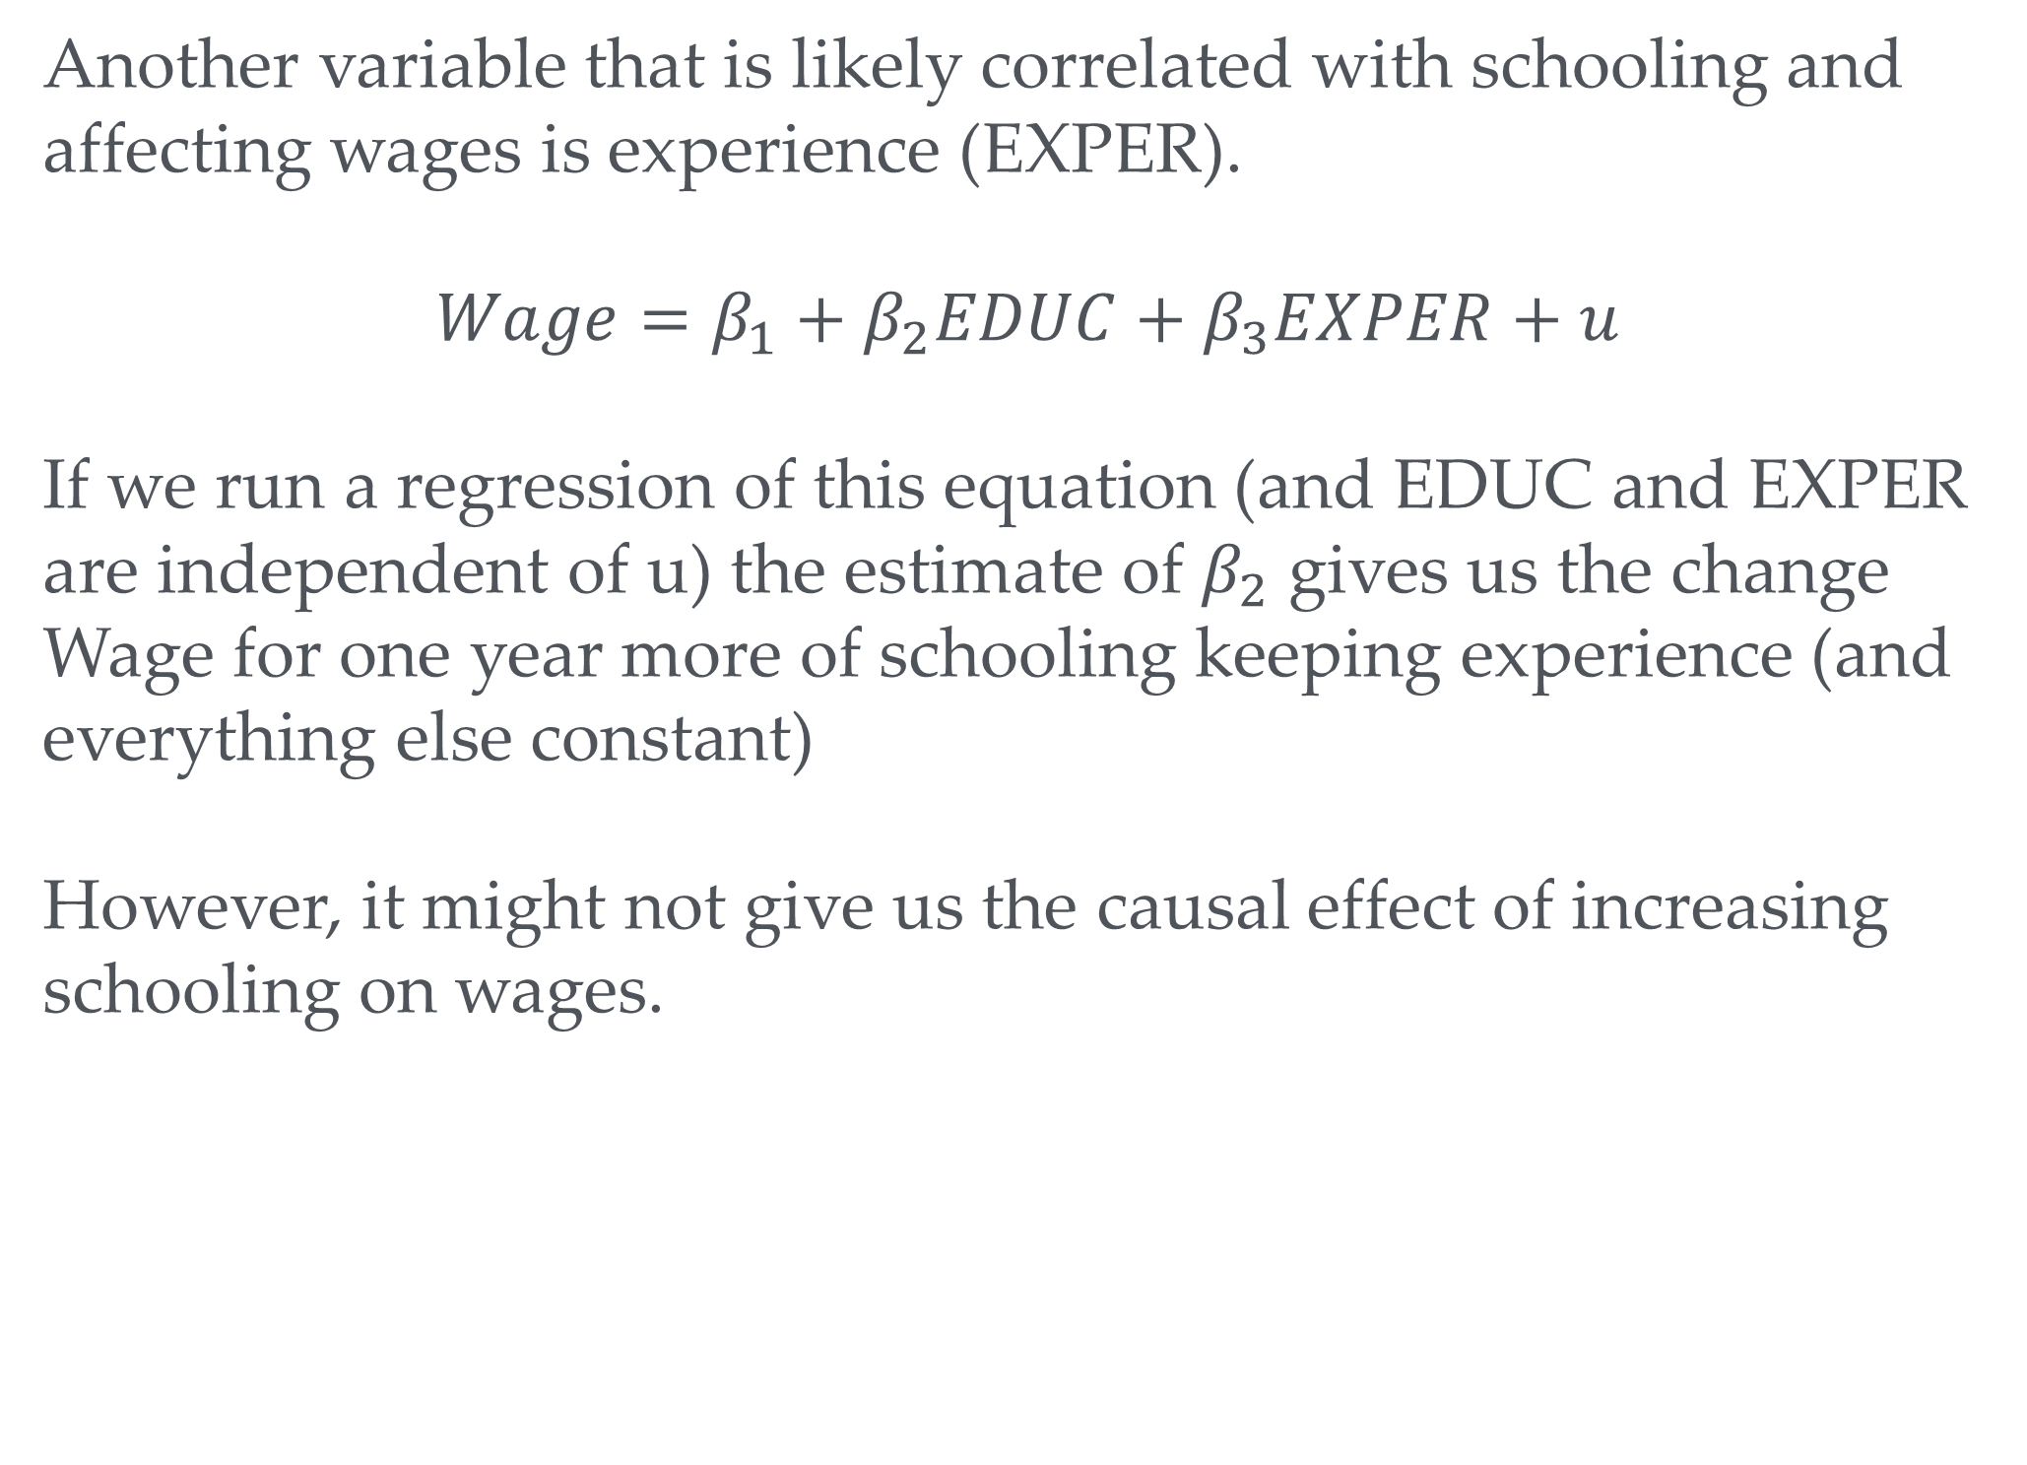
Causality vs all else equal
Another variable that is likely correlated with schooling and affecting wages is experience (EXPER).
$$Wage=β_{1}+β_{2}EDUC+β_{3}EXPER+u$$
If we run a regression of this equation (and EDUC and EXPER are independent of u) the estimate of $β_{2}$ gives us the change Wage for one year more of schooling keeping experience (and everything else constant)
However, it might not give us the causal effect of increasing schooling on wages.

Slide 11

Directions of causality EDU☞EXP
EDUC
Wage
-
+
$$EXPER$$
The reason why EDUC and EXPER are correlated is likely because of a chain of causality from schooling to experience (i.e. if you go to school longer you don’t have so much time to get job experience; also not that S is typically determined before EXPER which supports the suggested chain)
If you include EXPER as separate explanatory variable then your coefficient on EDUC will not reflect this causal channel. This is good if you really want the all else equal effect of EXPER. However, if you want the full causal effect of EDUC (e.g. you want to advise the government what an extra year of schooling does to wages) you get the wrong answer as you are pretending that you can have extra schooling without reducing people’s experience. So it would be better to exclude EXPER.

Slide 12
Directions of causality EDUC☜FEMALE
EDUC
Wage
-
-
Female
Gender is mostly (but not exclusively) determined before schooling
Hence the reason why EDUC and Female variable are correlated because of a causality chain from Female to EDUC.
In this case it is vital to include the Female variable to get the correct causal estimate of a change in EDUC

Slide 13
Directions of causality EDUC☞☜EXPER
EDUC=Schooling+Vocational
Wage
Suppose EDUC includes further education while working
EXPER
If the causality between the two explanatory variables goes both ways we are in trouble as far as finding the causal effect of EDUC is concerned (we are cool for finding the ceteris paribus effect). Both including or dropping the gender variable will lead to a biased estimate. We have to use other methods some of which we shall discuss later in the module.

Slide 14

Key insight: You can be too controlling
More control variables are not always better to identify a causal effect
To include or not include → depends on direction of causation between control and x var of interest
Sometimes there is no clear cut answer as causation goes both ways
Report regression with and without control and discuss limitations of your analysis
More research with other data or better model (e.g. Instrumental Variables which we discuss later) might be needed.
Might sometimes be beyond the scope of a study (e.g. in group coursework)

Slide 15
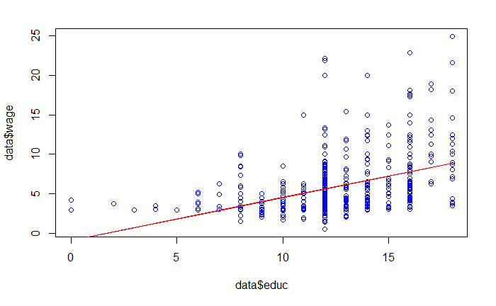
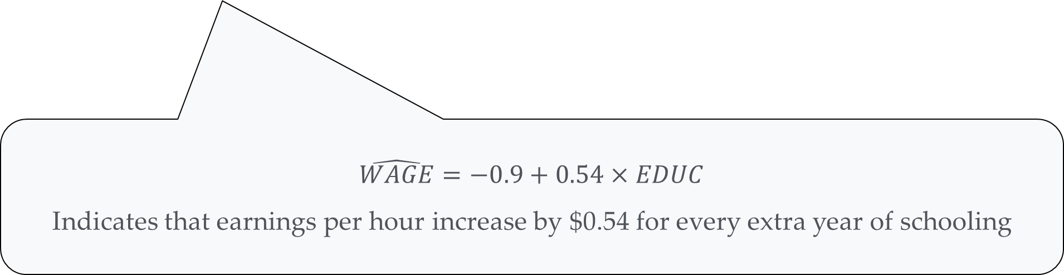
Multivariate OLS in practice – Let’s start univariate
data <- read.csv("https://www.dropbox.com/s/9agc2vmamfztlel/WAGE1.csv?dl=1")
mod1 <- lm(wage ~ educ, data) summary(mod1)
## ## Call: ## lm(formula = wage ~ educ, data = data) ## ## Residuals: ## Min 1Q Median 3Q Max ## -5.3396 -2.1501 -0.9674 1.1921 16.6085 ## ## Coefficients: ## Estimate Std. Error t value Pr(>|t|) ## (Intercept) -0.90485 0.68497 -1.321 0.187 ## educ 0.54136 0.05325 10.167 <2e-16 *** ## --- ## Signif. codes: 0 '***' 0.001 '**' 0.01 '*' 0.05 '.' 0.1 ' ' 1 ## ## Residual standard error: 3.378 on 524 degrees of freedom ## Multiple R-squared: 0.1648, Adjusted R-squared: 0.1632 ## F-statistic: 103.4 on 1 and 524 DF, p-value: < 2.2e-16
$$\hat{WAGE}=−0.9+0.54×EDUC$$
Indicates that earnings per hour increase by $0.54 for every extra year of schooling

Slide 16
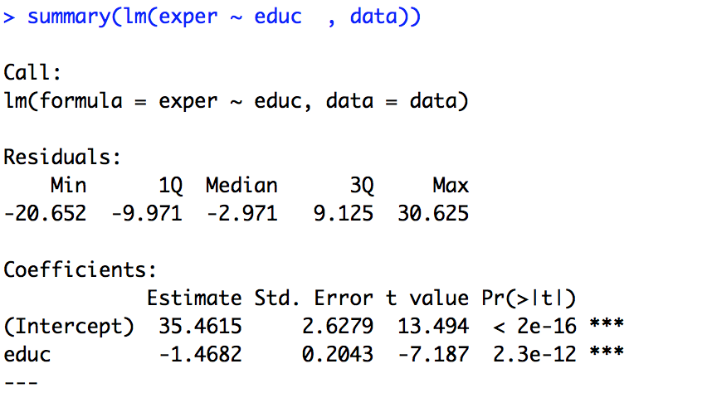
EDUC vs EXPER
One more year of education means 1.4 years less experience
Your turn: If we include exper as additional variable in a regression of WAGE what effect you expect that to have on the coefficient for education?
EDUC coefficient goes up
EDUC coefficient goes down
EDUC coefficient remains unchanged

Slide 17

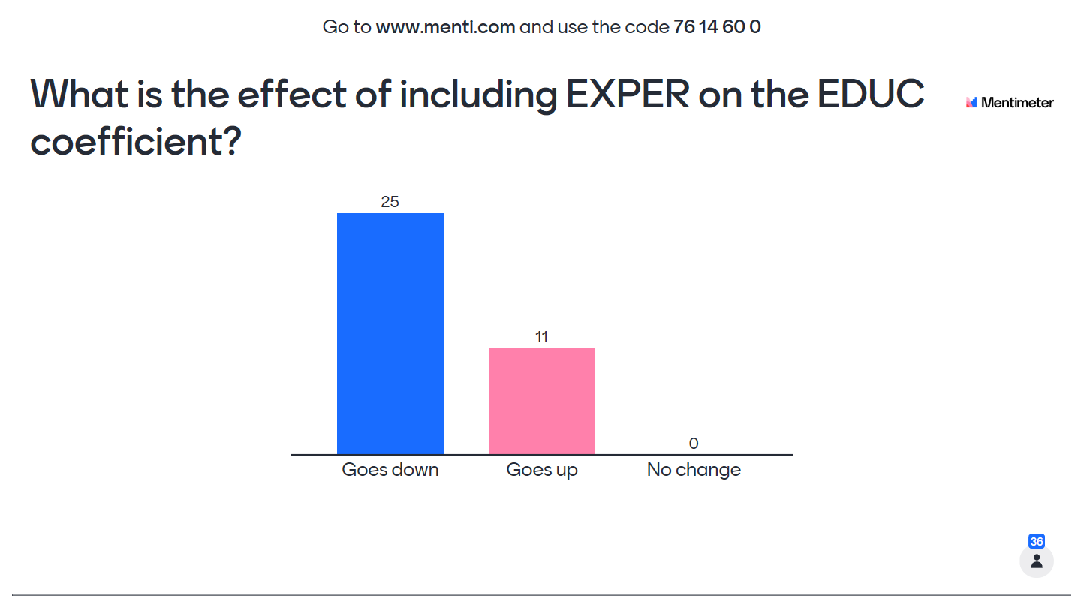
$$Wage=β_{1}+β_{2}EDU+ε$$
vs
$$Wage=β_{1}+β_{2}EDU+β_{3}EXPER+ε$$

Slide 18
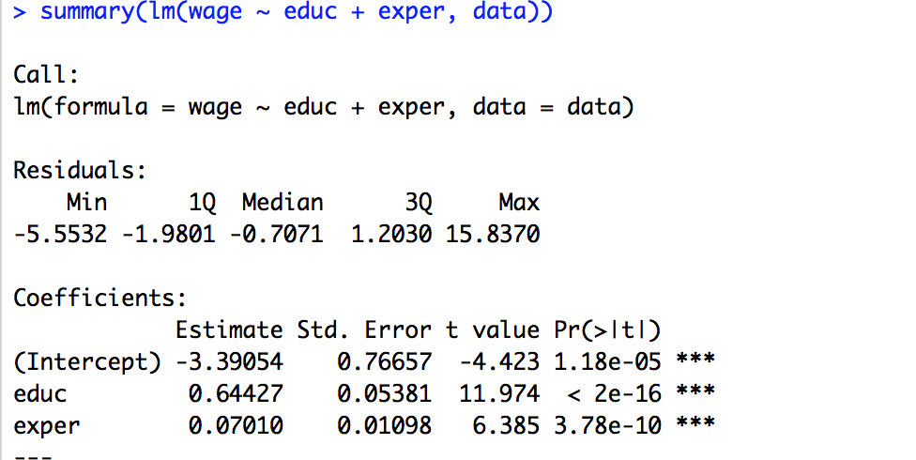
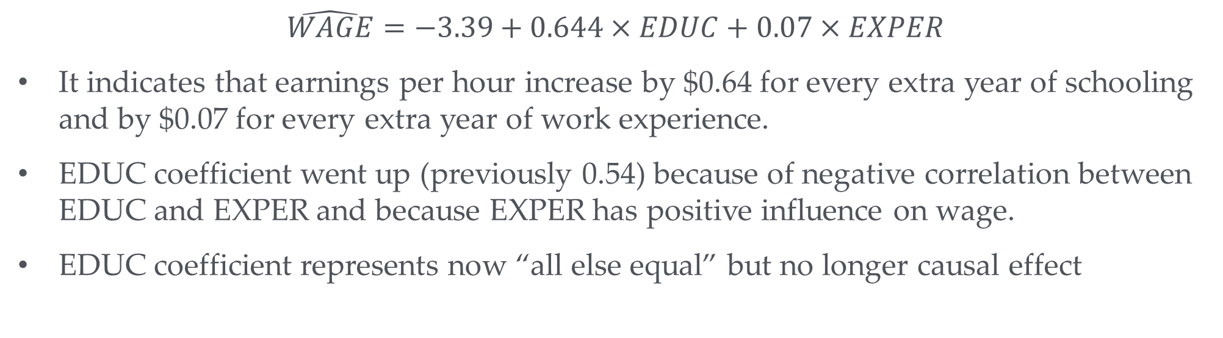
Multivariate OLS in practice
$$\hat{WAGE}=−3.39+0.644×EDUC+0.07×EXPER$$
It indicates that earnings per hour increase by $0.64 for every extra year of schooling and by $0.07 for every extra year of work experience.
EDUC coefficient went up (previously 0.54) because of negative correlation between EDUC and EXPER and because EXPER has positive influence on wage.
EDUC coefficient represents now “all else equal” but no longer causal effect

Slide 19
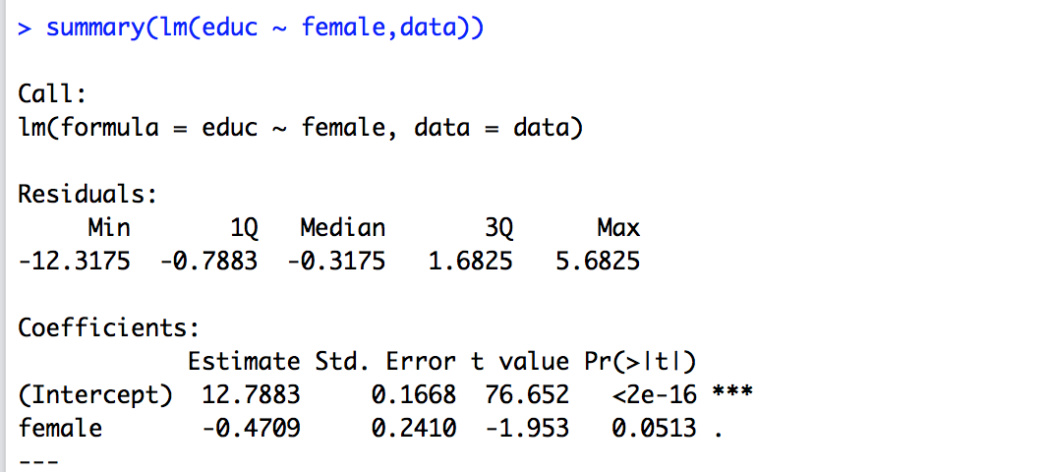
Wage & Gender
Women tend to be less educated than men

Slide 20
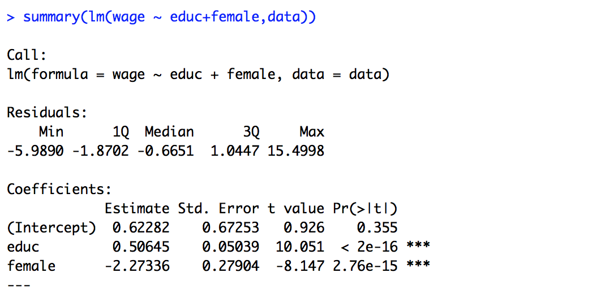
Wage & Gender
Including the Female variable makes the EDUC coefficient smaller
This is because women are paid less than men irrespective of education
Hence part of what we thought was the wage depressing effect of little education is actually the wage depressing effect of being female
Compare with EXPER which had a positive effect on wages

Slide 21
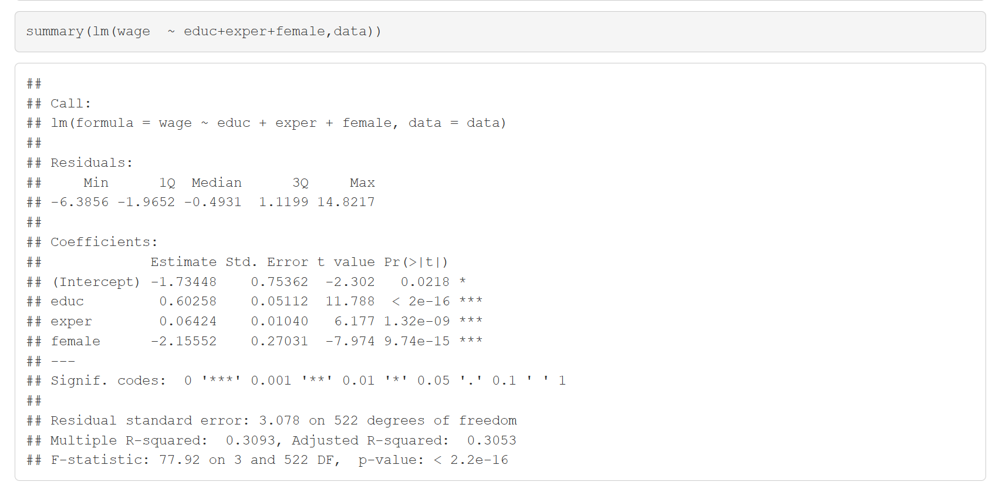
More than 2 variables

Slide 22
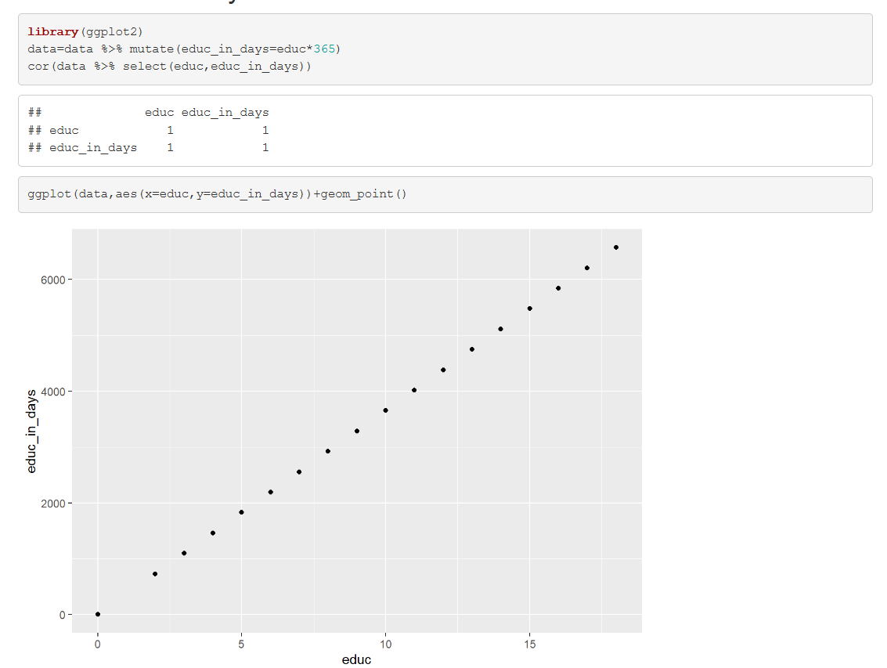
Perfect Multi-collinearity
A specific problem in the multivariate case
Sample has not enough variation in the explanatory variables
Implies perfect multi-collinearity
educ in days will be different numbers but it will be perfectly correlated with educ in years

Slide 23
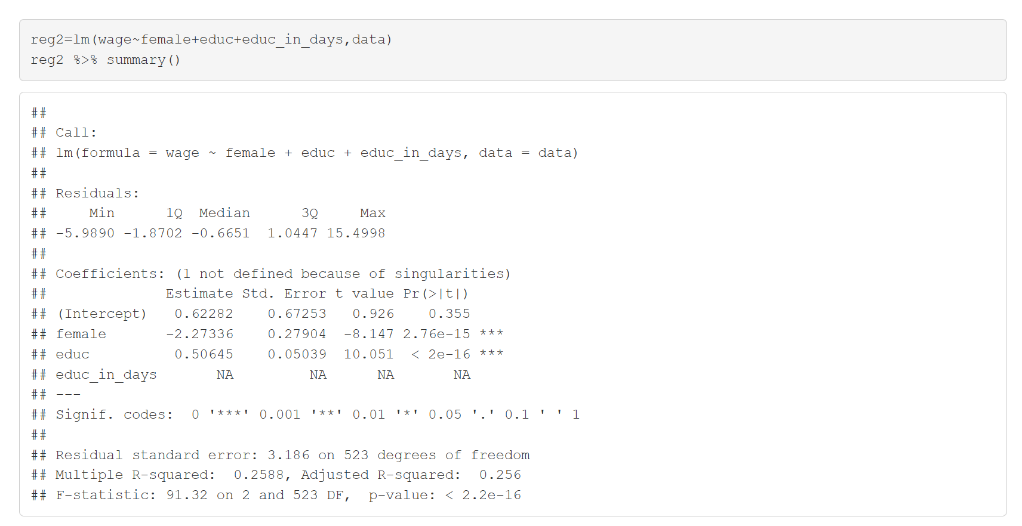
Perfect Multi-collinearity
We cannot work the effect of “educ in days” holding “educ in years” constant because all observations with a given “educ in years” all have the same “educ in days”
R will drop one of the variables to allow OLS
Which one is dropped has no meaning

Slide 24

Extra Slides

Slide 25


Accounting for variation: $R^{2}$
How much of the variation in $Y$ is accounted for by $\hat{Y}={\hat{β}}_{0}+{\hat{β}}_{1}X_{1}+{\hat{β}}_{2}X_{2}+…$?
For instance
Not so much
Most
$$R^{2}=\frac{VAR(\hat{Y})}{VAR(Y)}$$

Slide 26
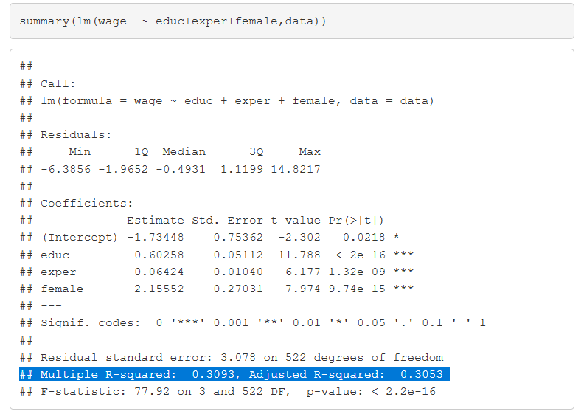

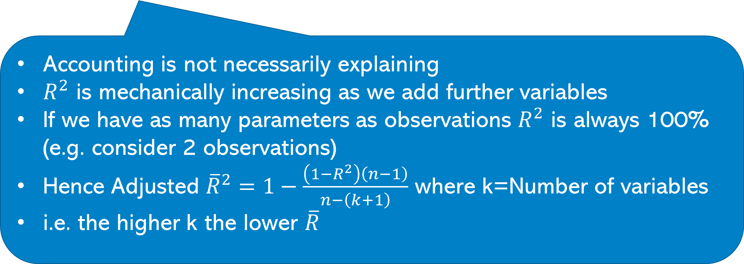
Finding $R^{2}$
Accounting is not necessarily explaining
$R^{2}$ is mechanically increasing as we add further variables
If we have as many parameters as observations $R^{2}$ is always 100% (e.g. consider 2 observations)
Hence Adjusted ${\overline{R}}^{2}=1−\frac{\left(1−R^{2}\right)\left(n−1\right)}{n−\left(k+1\right)}$ where k=Number of variables
i.e. the higher k the lower $\overline{R}$

Slide 27
R2=100%
If we have as many observations as parameters being estimated, R2 is always 100%

Slide 28
Back to the criminal foreigners
## lm(formula = crimesPc ~ b_migr11 + pop11, data = df) ## ## Residuals: ## Min 1Q Median 3Q Max ## -1.6243 -0.4052 -0.1253 0.2347 13.8304 ## ## Coefficients: ## Estimate Std. Error t value Pr(>|t|) ## (Intercept) 1.124e+00 1.018e-01 11.034 < 2e-16 *** ## b_migr11 4.105e-02 5.335e-03 7.694 1.77e-13 *** ## pop11 -1.033e-06 5.078e-07 -2.034 0.0428 * ## --- ## Signif. codes: 0 '***' 0.001 '**' 0.01 '*' 0.05 '.' 0.1 ' ' 1 ##
…those areas are less “crime intensive”
## lm(formula = b_migr11 ~ pop11, data = df) ## ## Residuals: ## Min 1Q Median 3Q Max ## -19.039 -5.187 -2.698 1.225 40.835 ## ## Coefficients: ## Estimate Std. Error t value Pr(>|t|) ## (Intercept) 6.240e+00 9.530e-01 6.548 2.18e-10 *** ## pop11 3.088e-05 4.883e-06 6.326 8.02e-10 ***
Foreigners come to more populous areas but ….

Slide 29
Back to the criminal foreigners
## lm(formula = crimesPc ~ b_migr11 + pop11 + urate2011 + medianage, ## data = df) ## ## Residuals: ## Min 1Q Median 3Q Max ## -0.8873 -0.2680 -0.0783 0.1434 3.1754 ## ## Coefficients: ## Estimate Std. Error t value Pr(>|t|) ## (Intercept) 3.689e+00 4.855e-01 7.599 3.57e-13 *** ## b_migr11 5.446e-03 3.879e-03 1.404 0.16130 ## pop11 -8.656e-07 2.793e-07 -3.099 0.00212 ** ## urate2011 4.016e-02 9.320e-03 4.309 2.20e-05 *** ## medianage -6.305e-02 1.027e-02 -6.138 2.55e-09 *** ## --- ## Signif. codes: 0 '***' 0.001 '**' 0.01 '*' 0.05 '.' 0.1 ' ' 1 ## ## Residual standard error: 0.4774 on 310 degrees of freedom ## (105 observations deleted due to missingness) ## Multiple R-squared: 0.3468, Adjusted R-squared: 0.3383
Migration Effect goes away if we control for population unemployment rate & median age
Is it always a good idea to control for those variables?
Can u think of an alternative strategy?

Slide 30
An Alternative Strategy
Pre 2004 foreigners
Post 2004 foreigners
Crime 2011
Foreign 2011
Unemployment 2004
Unemployment 2011

Slide 31
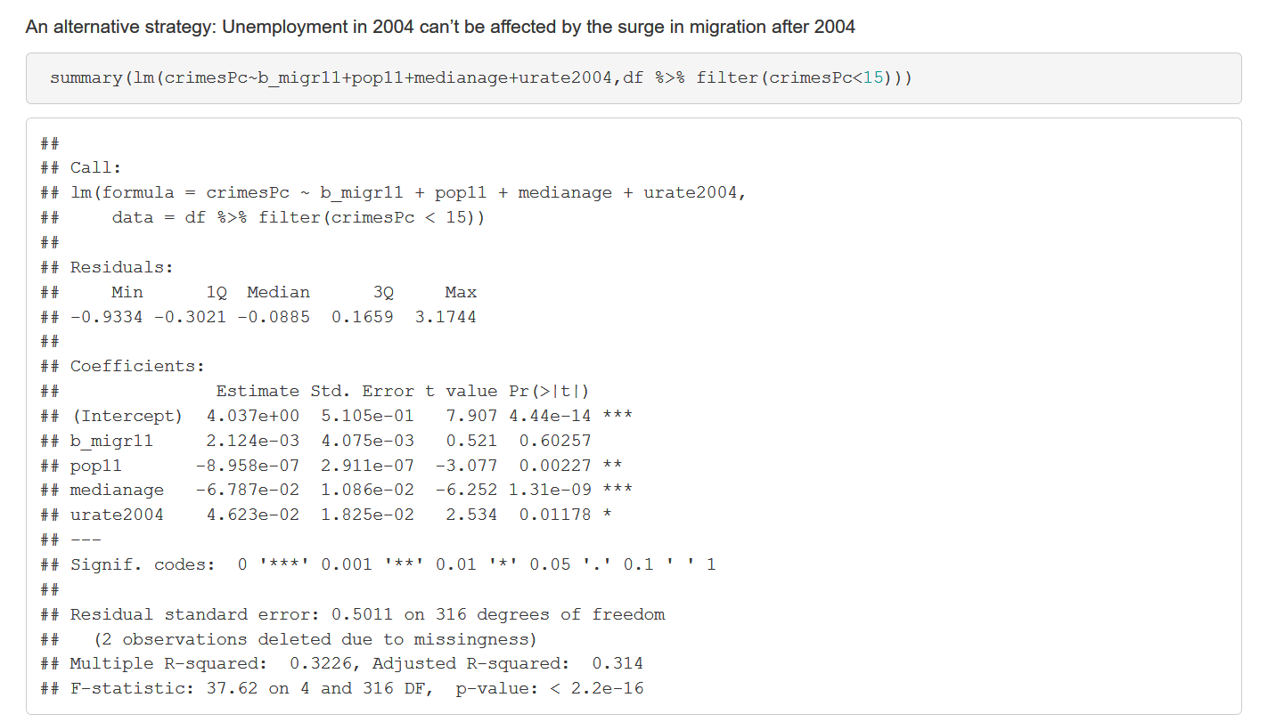
An Alternative Strategy
Migration coefficient:
Still not significant
Value has become slightly lower

Slide 32
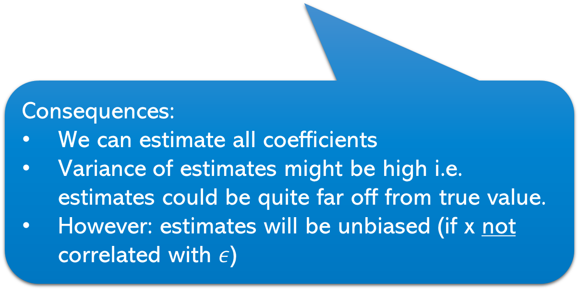
Imperfect Multi-collinearity
Explanatory variables are closely but no perfectly correlated
i.e. it’s hard – but no impossible – for the OLS algorithm to distinguish between the separate effects for all the variables
Consequences:
We can estimate all coefficients
Variance of estimates might be high i.e. estimates could be quite far off from true value.
However: estimates will be unbiased (if x not correlated with $ε$)
So what’s the problem?
Possibly none
Sometimes it won’t be possible to reliably identify all desired effects
You might think something doesn’t matter when it does.

Slide 33
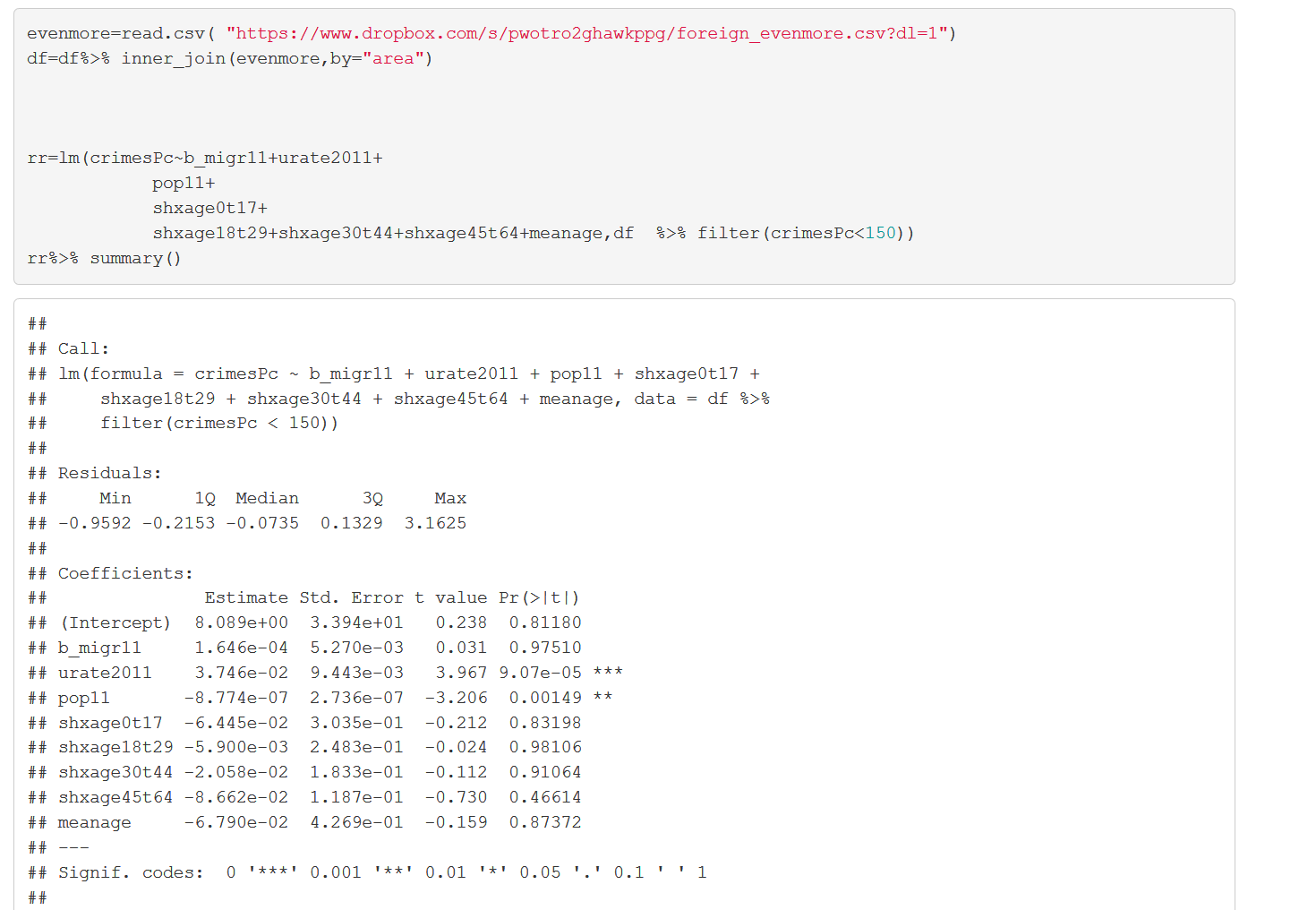
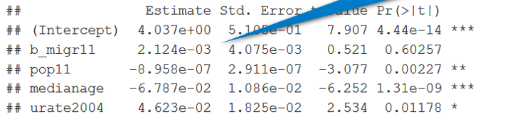
Imperfect Multi-collinearity: An example
We include a wider set of controls for age bands; e.g. shxage017 reports the share of 0-17 year olds in percent.
None of the age variables is significant. Does this mean the age of the population is not important in explaining crime?
Age mattered before. The reason it doesn’t matter now is because of collinearity

Slide 34
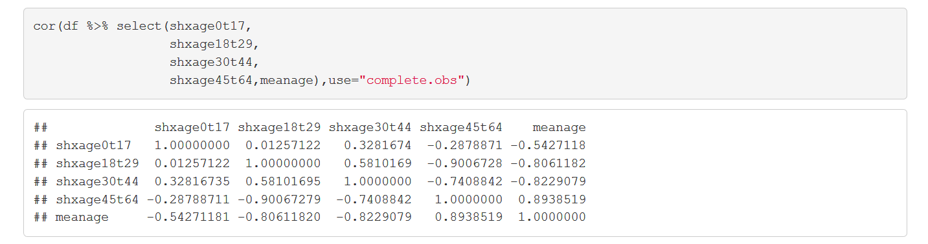
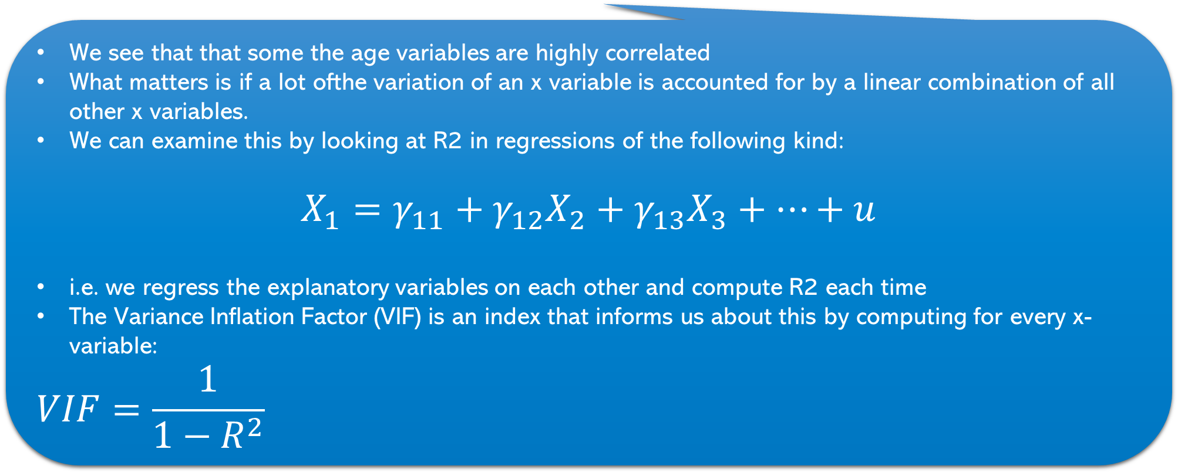
Imperfect Multi-collinearity: An example
We see that that some the age variables are highly correlated
What matters is if a lot ofthe variation of an x variable is accounted for by a linear combination of all other x variables.
We can examine this by looking at R2 in regressions of the following kind:
$$X_{1}=γ_{11}+γ_{12}X_{2}+γ_{13}X_{3}+…+u$$
i.e. we regress the explanatory variables on each other and compute R2 each time
The Variance Inflation Factor (VIF) is an index that informs us about this by computing for every x-variable:
$$VIF=\frac{1}{1−R^{2}}$$
VIF=1 → R2=0 → no problem
VIF>5 → R2>80% → maybe an issue

Slide 35

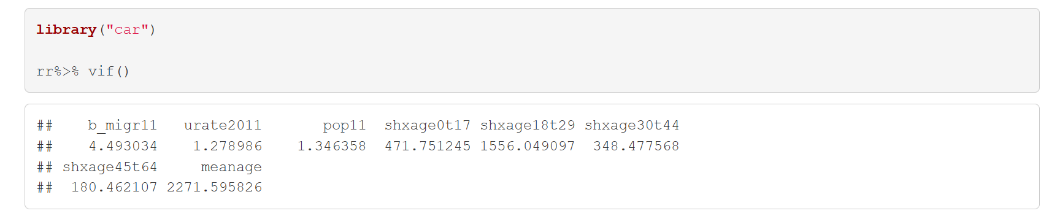
The Variance inflation factor in practice

Slide 36
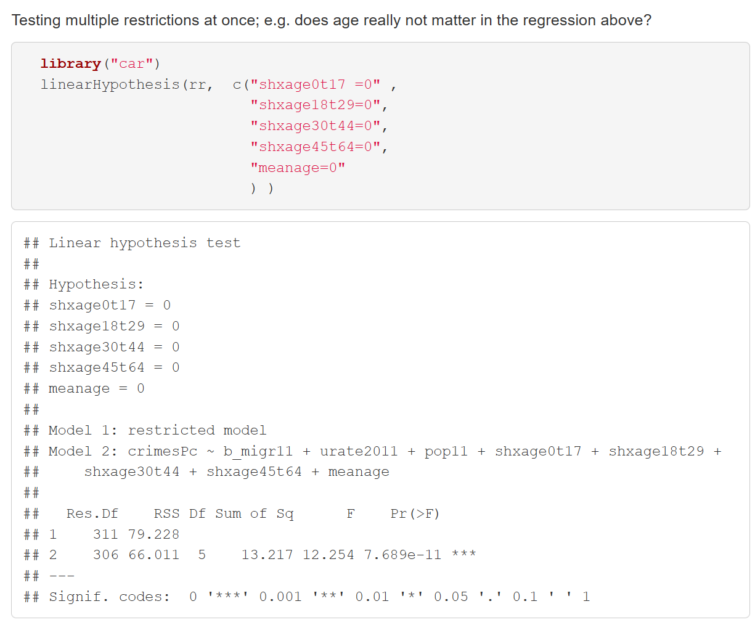
Joint Hypothesis Test
F-test….but it’s enough to look at the P value

Slide 37
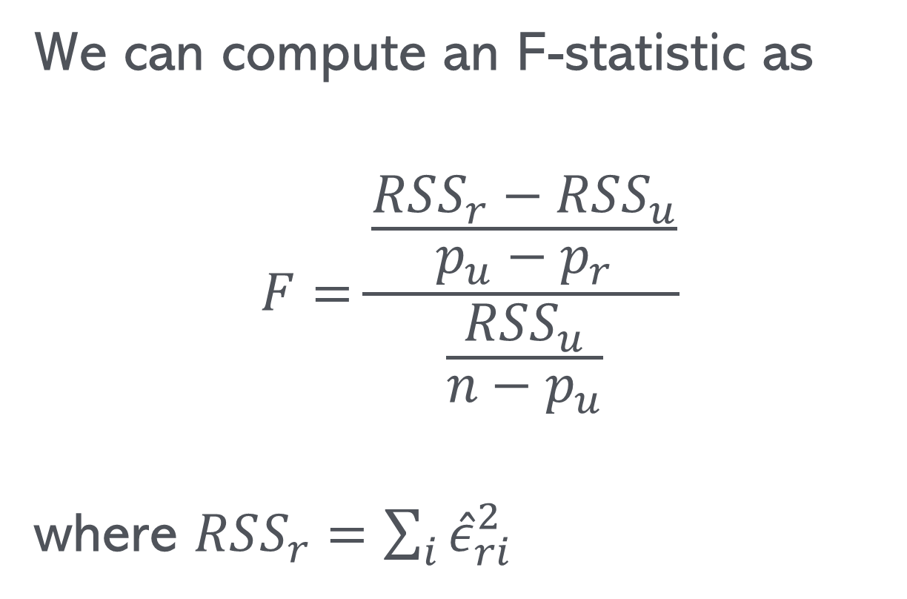
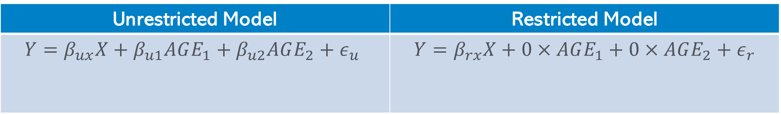
F-tests
Unrestricted Model | Restricted Model
$$Y=β_{ux}X+β_{u1}AGE_{1}+β_{u2}AGE_{2}+ε_{u}$$ | $$Y=β_{rx}X+0×AGE_{1}+0×AGE_{2}+ε_{r}$$
We can compute an F-statistic as
$$F=\frac{\frac{RSS_{r}−RSS_{u}}{p_{u}−p_{r}}}{\frac{RSS_{u}}{n−p_{u}}}$$
where $RSS_{r}=\sum_{i}{{\hat{ε}}_{ri}^{2}}$
2 parameters are restricted to be 0
How much more error do we get when restricting the model.
If it’s a lot (F big) then the restriction should be rejected
How do we know when F is big?
Somebody worked out how F is distributed (turns out his name was Fisher)

Slide 38
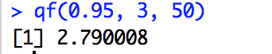
F distribution
After R.A. Fisher (1890-1962)
(did not work for Guinness)
F distribution has two arguments
Number of restrictions
Degrees of freedom unrestricted model
If each the F statistic is large it means that some or all of the hypothesis jointly tested are probably not true
Find critical value by equating this area to significance level; 5%

Slide 39
Takeaways
We can easily include further variables in a regression
There are two reasons we might want to do that
To deal with endogeneity
We are interested in several variables at the same time
Be careful about the causal relationships between explanatory variables
There might be collinearity, which might imply that we cannot (precisely) distinguish between the effects of several explanatory variables.
With several explanatory variables we might want to test several hypothesis combined.
We can use an F-test for that.

